Slide 1
Future of Blockchain
By Paras Dalal

Slide 2
General concept of Blockchain
Key Words:
Block (Page in ledger)
Data – Transactions, Timestamp, Previous block’s hash
Added to chain after proof of work & majority approval
Cryptography function (for security)
Hash
Distributed network (Multiple nodes)
Block once added to chain cannot be altered

Slide 3
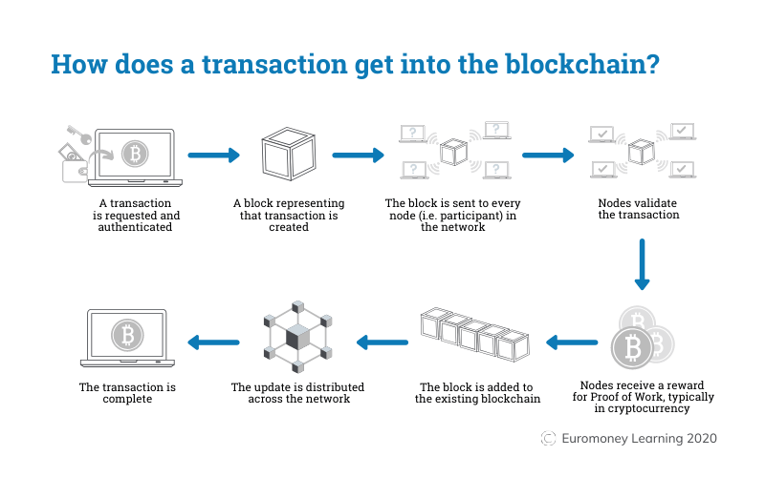
General concept of Blockchain

Slide 4
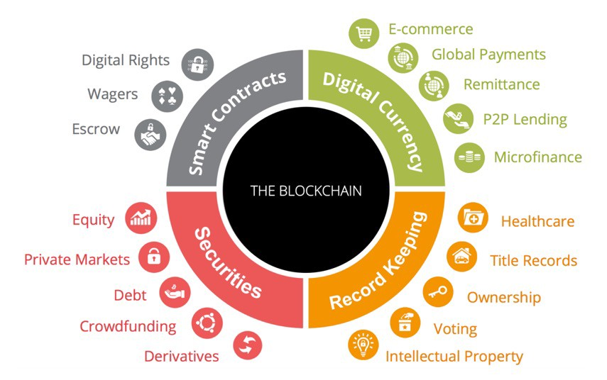
Future of Blockchain

Slide 5
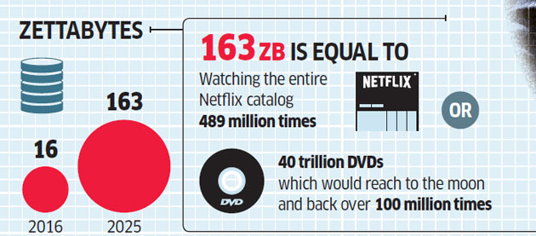
Example: Large Data
Data Overflow
1,000,000,000,000,000,000,000 (10²¹ = 1 Billion Terabytes)
Notes:
Example is FileCoin (Sia.tech)

Slide 6
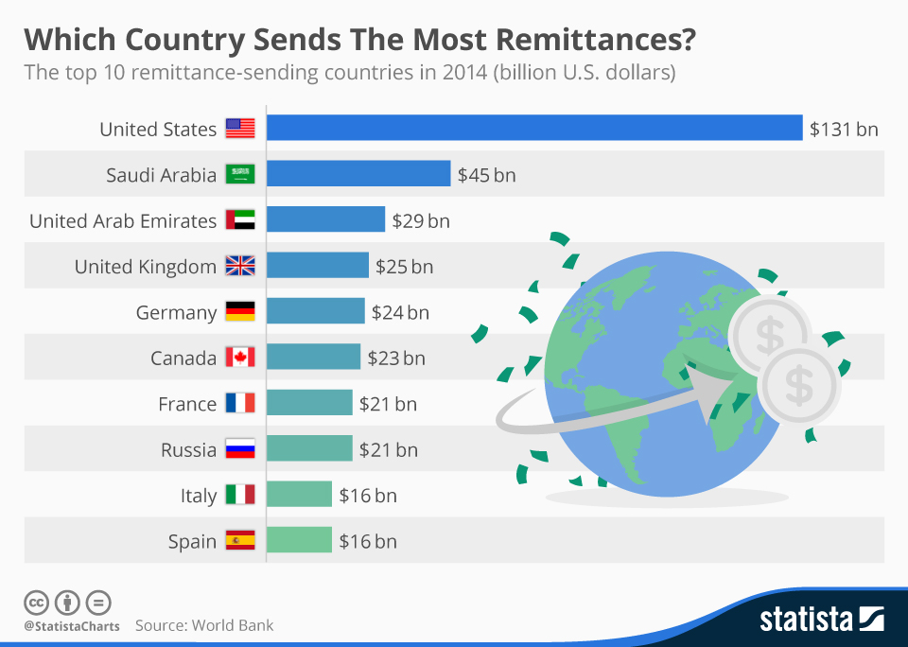
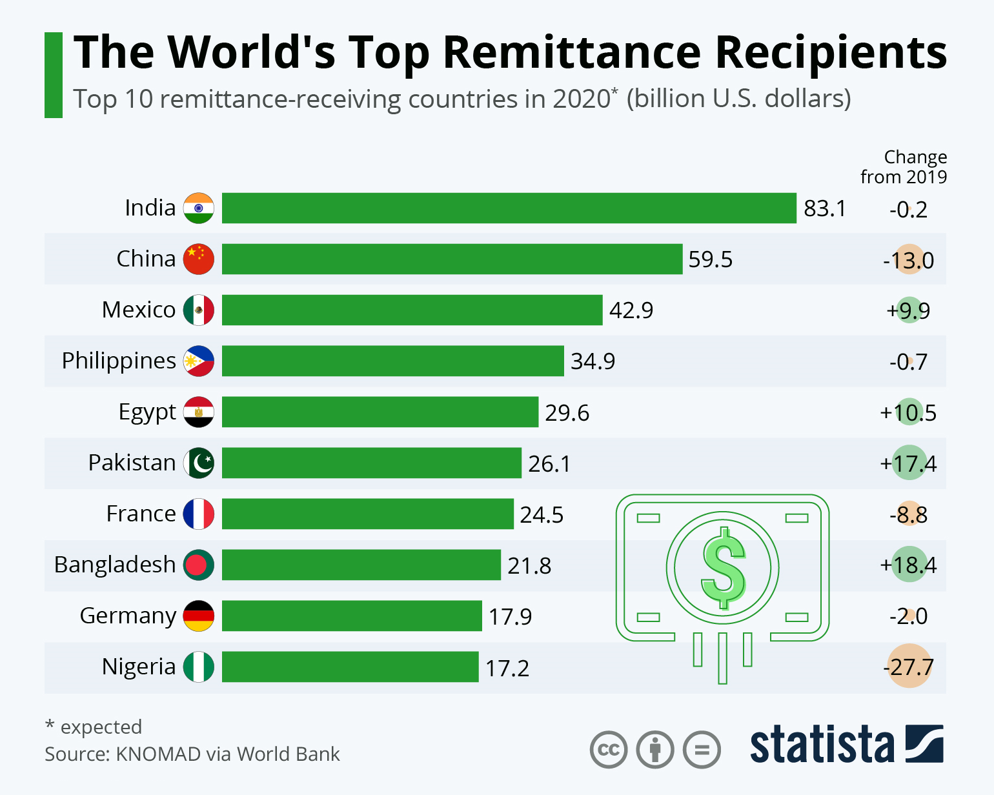
Example: transactions without central authority

Slide 7
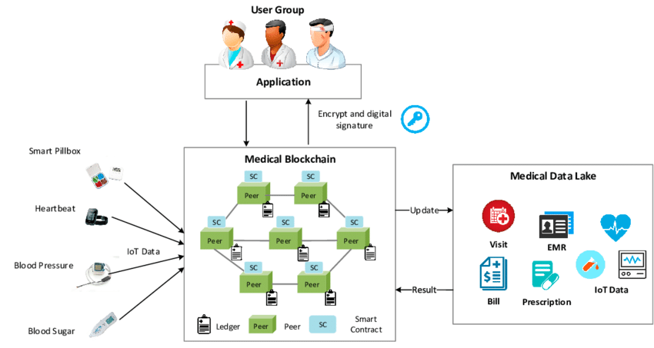
Example: Medical Records blockchain

Slide 8
Future blockchain applications
Transfer money – speed, no geographical boundry
Share medical information
Copyrighted music distribution (avoid piracy)
Real estate title insurance via decentralized title registry
Marriage licenses via smart contract (California)
Supply chain with transparency of origin
Tracking of shipments (DHL)

Slide 9
Problems of Blockchain
Lack of governance due to early stage of technology
Proof of work requires vast amount of computing power and electricity
Majority stakeholder in mining can alter transactions
Potential misuse due to inbuild anonymity
Large blockchain makes the speed of transactions slow

Slide 10
Relevance to Bessemer
May need to participate in various public blockchains
E.g. Zero day settlement using smart contracts
Crypto positions of our clients
May need to have private blockchain to reflect in our books
Speed of getting data to client
Private blockchain at our regional offices with historical data
Our clients may invest into digital assets
We need to be aware of underlying technology to guard their interests

Slide 11


